Slide 1
Module 4 – Part 1
Loops and Repetition

Slide 2
Outline
Motivation
while Loop Statement
do-while Loop Statement
for Loop Statement
Infinite Loops
Nested Loops
Using break and continue

Slide 3
1. Motivation
You want to print a string (e.g., "Welcome to CSE 1321!") a thousand times. You could copy/paste the following:
PRINTLINE("Welcome to CSE 1321!")
There has to be a better way! How do we solve this problem?
USING LOOPS

Slide 4
1. Loop Statements
Loops are repetition statements that allow us to execute a statement (or block of statements) multiple times
They are controlled by Boolean expressions
We will study three types of loop statements:
the while loop
the do-while loop
the for loop
We must choose the right type for the situation at hand

Slide 5
Loop Statements
The while and do-while loops run un-determined (unknown) number of iterations
The for loop, on the other hand, runs a pre-determined (known) number of iterations (some call it a counting loop)

Slide 6
Criteria for all loops
Have some initial condition
Starting a counter
Beginning in a certain state
Must have a test to continue
Must make progress towards finishing

Slide 7
2. while Loop Statement
A while loop (statement) has the following syntax:
WHILE (condition)
statement block //loop body
END WHILE
If the condition is true, the statement block is executed
Then the condition is evaluated again, and executes the statement until the condition becomes false
If the condition is false initially, the statement (loop body) is never executed
Therefore, the body of a while loop will execute zero or more times

Slide 8
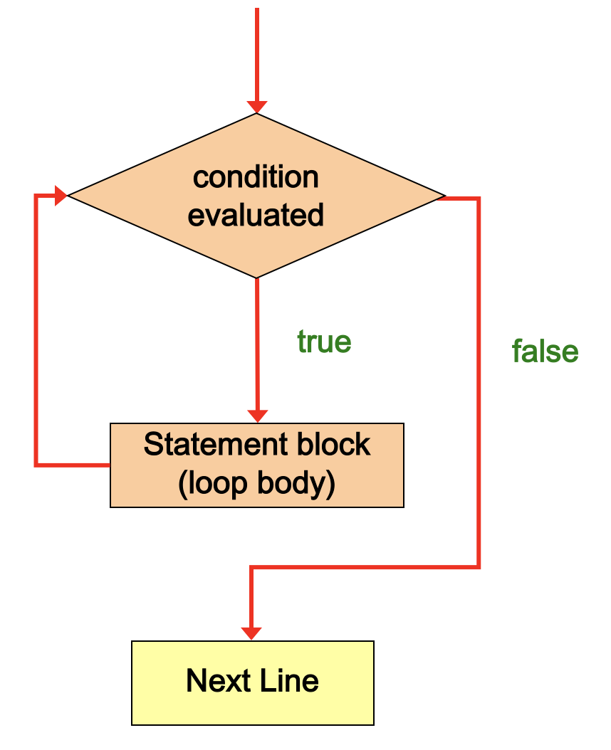
while Loop Logic
Note: If the initial evaluation of the condition is false, the loop body executes zero times. Therefore, the while loop executes zero or more times

Slide 9



Example: Writing 1,000 Sentences (using a while loop)
int counter = 1;
while (counter < 1000) {
PRINTLINE (counter + “I will not…”);
}
counter
1
Note: for actual code, replace PRINTLINE with your language’s printing

Slide 10
Example: Writing 1,000 Sentences (using a while loop)
int counter = 1;
while (counter < 1000) {
PRINTLINE (counter + “I will not…”);
}
counter
1

Slide 11
Example: Writing 1,000 Sentences (using a while loop)
int counter = 1;
while (counter < 1000) {
PRINTLINE (counter + “I will not…”);
}
Output: 1 I will not eat at Taco Bell again
counter
1

Slide 12
Example: Writing 1,000 Sentences (using a while loop)
int counter = 1;
while (counter < 1000) {
PRINTLINE (counter + “I will not…”);
}
counter
1

Slide 13
Example: Writing 1,000 Sentences (using a while loop)
int counter = 1;
while (counter < 1000) {
PRINTLINE (counter + “I will not…”);
}
counter
1

Slide 14
Example: Writing 1,000 Sentences (using a while loop)
int counter = 1;
while (counter < 1000) {
PRINTLINE (counter + “I will not…”);
}
Output: 1 I will not eat at Taco Bell again
counter
1

Slide 15
Example: Writing 1,000 Sentences (using a while loop)
int counter = 1;
while (counter < 1000) {
PRINTLINE (counter + “I will not…”);
}
counter
1

Slide 16
Example: Writing 1,000 Sentences (using a while loop)
int counter = 1;
while (counter < 1000) {
PRINTLINE (counter + “I will not…”);
}
counter
1

Slide 17
Example: Writing 1,000 Sentences (using a while loop)
int counter = 1;
while (counter < 1000) {
PRINTLINE (counter + “I will not…”);
}
Output: 1 I will not eat at Taco Bell again
counter
1

Slide 18
Infinite Loops
This loop isn’t making a lot of progress!
Loops that repeat forever are called infinite loops
Apparently “lock up”
Output:
1 I will not eat at Taco Bell again
1 I will not eat at Taco Bell again
1 I will not eat at Taco Bell again
1 I will not eat at Taco Bell again
.
.
.

Slide 19
Problem Solved
int counter = 1;
while (counter < 1000) {
PRINTLINE (counter + “I will not…”);
counter++;
}
counter
1

Slide 20
Problem Solved
int counter = 1;
while (counter < 1000) {
PRINTLINE (counter + “I will not…”);
counter++;
}
counter
1

Slide 21
Problem Solved
int counter = 1;
while (counter < 1000) {
PRINTLINE (counter + “I will not…”);
counter++;
}
Output: 1 I will not eat at Taco Bell again
counter
1

Slide 22
Problem Solved
int counter = 1;
while (counter < 1000) {
PRINTLINE (counter + “I will not…”);
counter++;
}
counter
2
// Remember, counter++; is the same as // counter = counter + 1

Slide 23
Problem Solved
int counter = 1;
while (counter < 1000) {
PRINTLINE (counter + “I will not…”);
counter++;
}
counter
2

Slide 24
Problem Solved
int counter = 1;
while (counter < 1000) {
PRINTLINE (counter + “I will not…”);
counter++;
}
counter
2

Slide 25
Problem Solved
int counter = 1;
while (counter < 1000) {
PRINTLINE (counter + “I will not…”);
counter++;
}
Output: 2 I will not eat at Taco Bell
counter
2

Slide 26
Problem Solved
int counter = 1;
while (counter < 1000) {
PRINTLINE (counter + “I will not…”);
counter++;
}
counter
3

Slide 27
How does it end?
int counter = 1;
while (counter < 1000) {
PRINTLINE (counter + “I will not…”);
counter++;
}
counter
999

Slide 28
How does it end?
int counter = 1;
while (counter < 1000) {
PRINTLINE (counter + “I will not…”);
counter++;
}
counter
999

Slide 29
How does it end?
int counter = 1;
while (counter < 1000) {
PRINTLINE (counter + “I will not…”);
counter++;
}
counter
999

Slide 30
How does it end?
int counter = 1;
while (counter < 1000) {
PRINTLINE (counter + “I will not…”);
counter++;
}
Output: 999 I will not eat at Taco Bell again
counter
999

Slide 31
How does it end?
int counter = 1;
while (counter < 1000) {
PRINTLINE (counter + “I will not…”);
counter++;
}
counter
1000

Slide 32
How does it end?
int counter = 1;
while (counter < 1000) {
PRINTLINE (counter + “I will not…”);
counter++;
}
counter
1000

Slide 33
How does it end?
int counter = 1;
while (counter < 1000) {
PRINTLINE (counter + “I will not…”);
counter++;
}
// So we never print out
// 1000 I will not eat at Taco Bell again
now false
counter
1000

Slide 34
Another Problem Solved
int counter = 1;
while (counter <= 1000) {
PRINTLINE (counter + “I will not…”);
counter++;
}
now true
counter
1000

Slide 35
A Closer Look on the Incremental Operator
The Incremental Operator (++) and the Decremental Operator (--) have two different notations (Prefix and Postfix) that have different effect but usually NOT while used as loop counter.
Similar output will be found if we the prefix notation of the Incremental Operator here as (++counter)
int counter = 1;
while (counter <= 1000) {
PRINTLINE (counter + “I will not…”);
++counter;
}
now true
counter
1000

Slide 36
Prefix Vs Postfix Notations of the Incremental and Decremental Operators with a while Loop
Let’s understand the Exact output of the following Code Segment
int counter = 0, x = 0, y = 0;
while(counter < 5){
PRINT("x = " + ++x + "\t");
PRINT("y = " + y++ + "\n");
counter++; // or ++counter
} // End of while
Output:
??
Do you see any difference if use ?
counter++ or ++counter No
++x or x++ Yes
y++ or ++y Yes, But Why?
Please Test it Yourself

Slide 37
Prefix Vs Postfix Notations of the Incremental and Decremental Operators with a while Loop
Let’s understand the Exact output of the following Code Segment
int counter = 0, x = 0, y = 0;
while(counter < 5){
PRINT("x = " + ++x + "\t");
PRINT("y = " + y++ + "\n");
counter++; // or ++counter
} // End of while
Output:
x = 1 y = 0
x = 2 y = 1
x = 3 y = 2
x = 4 y = 3
x = 5 y = 4
Do you see any difference if use ?
counter++ or ++counter No
++x or x++ Yes
y++ or ++y Yes, But Why?

Slide 38
Sentinel Values
Question: How can the user control a while loop?
A sentinel value is a special input value that represents the end of inputs from the user
The sentinel value should be included in the prompt so that the user knows how to stop the loop. For example,
PRINTLINE(“Enter a grade (type 9999 to quit):”)
A sentinel value gives the user control over the loop

Slide 39
Input Validation
A while loop can be used for input validation, making a program more robust
Ensure correct input values before processing
Can issue error messages for invalid data

Slide 40
In-class Problem: Input Validation
Problem Statement: Write a program in which you allow your user to guess a secret number between 1 and 10. For this example, set your secret number to a literal for easy testing. When you are done, think about you can modify the program to allow the user to continue to guess until they get it right. Also, think about how you could use conditionals to give them valuable feedback to reach the answer!

Slide 41
Pseudocode – Input Validation
BEGIN MAIN
userGuess ← 0, secretNumber ← 5
PRINT “Enter a number between 1 and 10”
READ userGuess
WHILE (userGuess < 1 OR userGuess > 10) PRINTLINE “That is not between 1 and 10. Try again.” READ userGuess ENDWHILE IF (userGuess == secretNum) THEN PRINTLINE “That’s right! ” + userGuess + “ is the secret!” ELSE PRINTLINE userGuess + “ is not the secret!” ENDIF
END MAIN
Ps

Slide 42
Input Validation Example
int userGuess = 0, secretNum = 5;
PRINT("Enter a number between 1 and 10: ");
userGuess = READ();
while(userGuess < 1 || userGuess > 10)
{
PRINT ("Not between 1 and 10. Try again!");
userGuess = READ();
}
if (userGuess == secretNum)
{
PRINT(userGuess + " is the secret number!");
}
else
{
PRINT(userGuess + " isn’t the secret number!");
}

Slide 43
3. do-while Loop
A do-while loop has the following syntax:
DO
//statement block
WHILE (condition)
END DO-WHILE
The statement is executed a minimum once initially, and then the condition is evaluated
The statement is executed repeatedly until the condition becomes false

Slide 44
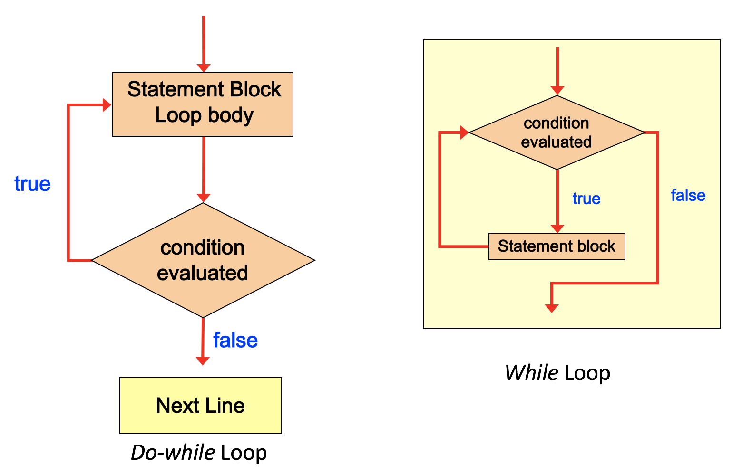
Logic of do-while Loop

Slide 45
Example (count from 1 to 3)
int counter = 0;
do {
counter++;
PRINTLINE (counter);
} while (counter < 3);
counter
0

Slide 46
Example (count from 1 to 3)
int counter = 0;
do {
counter++;
PRINTLINE (counter);
} while (counter < 3);
counter
0

Slide 47
Example (count from 1 to 3)
int counter = 0;
do {
counter++;
PRINTLINE (counter);
} while (counter < 3);
counter
1

Slide 48
Example (count from 1 to 3)
int counter = 0;
do {
counter++;
PRINTLINE (counter);
} while (counter < 3);
counter
1
Output: 1

Slide 49
Example (count from 1 to 3)
int counter = 0;
do {
counter++;
PRINTLINE (counter);
} while (counter < 3);
counter
1

Slide 50
Example (count from 1 to 3)
int counter = 0;
do {
counter++;
PRINTLINE (counter);
} while (counter < 3);
counter
2

Slide 51
Example (count from 1 to 3)
int counter = 0;
do {
counter++;
PRINTLINE (counter);
} while (counter < 3);
counter
2
Output: 2

Slide 52
Example (count from 1 to 3)
int counter = 0;
do {
counter++;
PRINTLINE (counter);
} while (counter < 3);
counter
2

Slide 53
Example (count from 1 to 3)
int counter = 0;
do {
counter++;
PRINTLINE (counter);
} while (counter < 3);
// Note: counter is now 3, but we still have
// to finish out the loop – it doesn’t skip
counter
3

Slide 54
Example (count from 1 to 3)
int counter = 0;
do {
counter++;
PRINTLINE (counter);
} while (counter < 3);
counter
3
Output: 3

Slide 55
Example (count from 1 to 3)
int counter = 0;
do {
counter++;
PRINTLINE (counter);
} while (counter < 3);
counter
3
now false, so loop is finished

Slide 56
Pseudocode – do-while Loop Example
Problem Statement: Write a program in which you enable your user to enter a number. Using a do-while loop, output the reverse display of that number.

Slide 57
Pseudocode – do-while Loop Example
BEGIN MAIN CREATE number ← 0, lastDigit ← 0, reverse ← 0
PRINT “Enter a positive number.”
READ number
DO lastDigit ← number % 10
reverse ← (reverse * 10) + lastDigit
number ← number / 10
WHILE (number > 0) ENDDO
END MAIN
Ps

Slide 58
do-while Loop Example
int number, lastDigit, reverse = 0;
PRINT ("Enter a positive integer: ");
number = READ();
do
{
lastDigit = number % 10;
reverse = (reverse * 10) + lastDigit;
number = number / 10;
} while (number > 0); // NOTE THE SEMICOLON!!!!!!
PRINT ("The reversed is " + reverse);

Slide 59
4. for Loop
A for statement has the following syntax:
The initialization
is executed once
before the loop begins
The statement is
executed until the
condition becomes false
FOR (initialization, condition, increment)
statement Block ENDFOR
The increment portion is executed at the end of each iteration
Collectively, the parameters in the FOR header identify the iteration bounds of the loop.

Slide 60
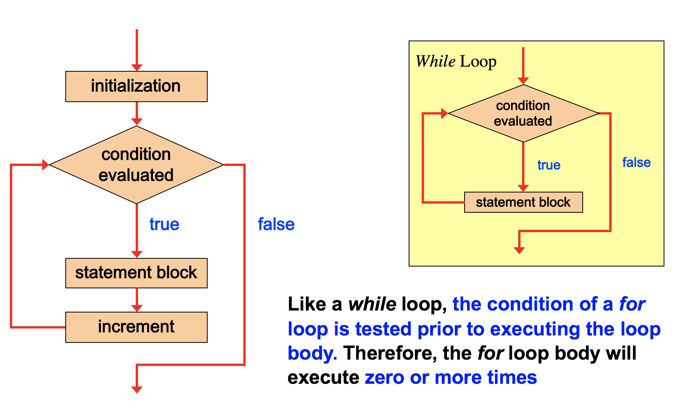
for Loop Logic

Slide 61
for Loop as a while Loop
A for loop is functionally equivalent to the following while loop structure:
FOR (initialization, condition, increment)
statement block
ENDFOR
initialization
WHILE (condition) statement block
increment
ENDWHILE

Slide 62
“Equivalency” of while and for loops
FOR (count ← 1, count <= 5, count ← count + 1)
PRINTLINE count
ENDFOR
count ← 1
WHILE (count <= 5)
PRINTLINE count
count ← count + 1
ENDWHILE
Ps

Slide 63
Walkthrough of a for loop
1000 sentences again? No problem…
int counter;
for (counter = 1; counter <= 1000; counter++) {
PRINTLINE (counter + “I will not…”);
}

Slide 64
Why this works
int counter;
for (counter = 1; counter <= 1000; counter++) {
PRINTLINE (counter + “I will not…”);
}
counter
1

Slide 65
Why this works
int counter;
for (counter = 1; counter <= 1000; counter++) {
PRINTLINE (counter + “I will not…”);
}
counter
true
1

Slide 66
Why this works
int counter;
for (counter = 1; counter <= 1000; counter++) {
PRINTLINE (counter + “I will not…”);
}
Output: 1 I will not eat Taco Bell.
counter
1

Slide 67
Why this works
int counter;
for (counter = 1; counter <= 1000; counter++) {
PRINTLINE (counter + “I will not…”);
}
counter
2

Slide 68
Why this works
int counter;
for (counter = 1; counter <= 1000; counter++) {
PRINTLINE (counter + “I will not…”);
}
counter
true
2

Slide 69
Why this works
int counter;
for (counter = 1; counter <= 1000; counter++) {
PRINTLINE (counter + “I will not…”);
}
Output: 2 I will not eat Taco Bell.
counter
2

Slide 70
Why this works
int counter;
for (counter = 1; counter <= 1000; counter++) {
PRINTLINE (counter + “I will not…”);
}
counter
3

Slide 71
Why this works
int counter;
for (counter = 1; counter <= 1000; counter++) {
PRINTLINE (counter + “I will not…”);
}
counter
true
3

Slide 72
Why this works
int counter;
for (counter = 1; counter <= 1000; counter++) {
PRINTLINE (counter + “I will not…”);
}
Output: 3 I will not eat Taco Bell.
counter
3

Slide 73
Why this works
int counter;
for (counter = 1; counter <= 1000; counter++) {
PRINTLINE (counter + “I will not…”);
}
counter
4

Slide 74
When will it end?
We see that this will go on for a while
It’s a little more interesting later around 1000

Slide 75
Why this works
int counter;
for (counter = 1; counter <= 1000; counter++) {
PRINTLINE (counter + “I will not…”);
}
counter
true
999

Slide 76
Why this works
int counter;
for (counter = 1; counter <= 1000; counter++) {
PRINTLINE (counter + “I will not…”);
}
Output: 999 I will not eat Taco Bell.
counter
999

Slide 77
Why this works
int counter;
for (counter = 1; counter <= 1000; counter++) {
PRINTLINE (counter + “I will not…”);
}
counter
1000

Slide 78
Why this works
int counter;
for (counter = 1; counter <= 1000; counter++) {
PRINTLINE (counter + “I will not…”);
}
true for last time
counter
1000

Slide 79
Why this works (are we finished?)
int counter;
for (counter = 1; counter <= 1000; counter++) {
PRINTLINE (counter + “I will not…”);
}
Output: 1000 I will not eat Taco Bell.
counter
1000

Slide 80
Why this works
int counter;
for (counter = 1; counter <= 1000; counter++) {
PRINTLINE (counter + “I will not…”);
}
counter
1001

Slide 81
Why this works
int counter;
for (counter = 1; counter <= 1000; counter++) {
PRINTLINE (counter + “I will not…”);
} // Jump down here and continue
…
…
false
counter
1001

Slide 82
Prefix Vs Postfix Notations of the Incremental and Decremental Operators with a For Loop
Let’s understand the Exact output of the following Code Segment
int counter = 0, x = 0, y = 0;
for ( ; counter < 5; ){
PRINT("x = " + ++x + "\t");
PRINT("y = " + y++ + "\n");
counter++; // or ++counter;
} // End of for
Output:
??
Do you see any difference if use ?
counter++ or ++counter No
++x or x++ Yes
y++ or ++y Yes, But Why?
Please Test it Yourself

Slide 83
Prefix Vs Postfix Notations of the Incremental and Decremental Operators with a For Loop
Let’s understand the Exact output of the following Code Segment
int counter = 0, x = 0, y = 0;
for ( ; counter < 5; ){
PRINT("x = " + ++x + "\t");
PRINT("y = " + y++ + "\n");
counter++; // or ++counter;
} // End of for
Output:
x = 1 y = 0
x = 2 y = 1
x = 3 y = 2
x = 4 y = 3
x = 5 y = 4
Do you see any difference if use ?
counter++ or ++counter No
++x or x++ Yes
y++ or ++y Yes, But Why?

Slide 84
Final Output
1 I will not eat at Taco Bell.
2 I will not eat at Taco Bell.
3 I will not eat at Taco Bell.
4 I will not eat at Taco Bell.
.
.
.
999 I will not eat at Taco Bell.
1000 I will not eat at Taco Bell.

Slide 85
In-class Problem:
Problem Statement: Write a program in which you enable your user to enter a number for which they want to see the multiplication table.

Slide 86
Pseudocode – for Loop Example
BEGIN MAIN CREATE userChoice ← 0
PRINT “Choose a number to see the multiplication table.”
READ userChoice
FOR (multiplier ← 1, multiplier < 12, multiplier ← multiplier + 1) PRINTLINE userChoice + “ * “ + multiplier + “ = “ + (multiplier * userChoice) ENDFOR END MAIN
Ps

Slide 87
for Loop Example
int choice = 0;
PRINT("Enter a number to see the table.");
choice = READ();
for(int multiplier = 1; multiplier <= 12; multiplier += 1)
{
PRINT (multiplier + " * " + choice +
" = " + (multiplier * choice));
}

Slide 88
5. Infinite Loops
The body of a while loop eventually must make the condition false
If not, it is called an infinite loop, which will execute until the user interrupts the program
This is a common logical error – so double check!

Slide 89
Example
An example of an infinite loop:
count ← 1
WHILE (count <= 25)
PRINTLINE count
count ← count - 1 //Error
ENDWHILE
This loop will continue executing until interrupted or until an underflow error occurs
Ps

Slide 90
Be Careful!
If the condition is left out, it is always considered to be true, and therefore creates an infinite loop
If the increment is left out, no increment operation is performed, and therefore creates an infinite loop
FOR (count ← 1, count <= 5, count ← count+1)
PRINTLINE count
ENDFOR

Slide 91
6. Nested Loops
Similar to nested if statements, loops contain other loop statements
For each iteration of the outer loop, the inner loop iterates completely

Slide 92
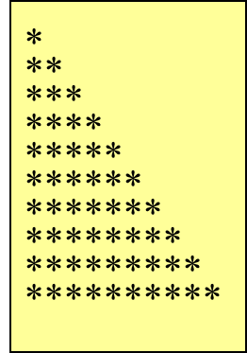
Pseudocode – Nested for Loop Example
Problem Statement: Write a program that uses nested for loops to print 10 rows of stars, as shown in the picture to the right.

Slide 93
Pseudocode – Nested for Loop Example
BEGIN MAIN CREATE maxRows ← 10, row, star
FOR (row ← 1, row < maxRows, row ← row + 1)
FOR (star ← 1, star <= row, star ← star + 1)
PRINT “*”
ENDinnerFOR
PRINTLINE () ENDouterFOR
END MAIN
Ps

Slide 94
Nested for Loop Example
int maxRows = 10;
for (int row = 1; row <= maxRows; row++) { for (int star = 1; star <= row; star++) { PRINT ("*"); }
PRINTLINE(); }

Slide 95
Nested Loops Iterations
How many times will the string "I am here" be printed?
BEGIN MAIN count1 ← 1 WHILE (count1 <= 10) count2 ← 1 WHILE (count2 <= 5) PRINT "I am here!" count2 ← count2 + 1 END inner WHILE PRINTLINE count1 ← count1 + 1 END outer WHILE END MAIN
Ps

Slide 96
7. Using break and continue
We can additionally control the flow of how loops work with keywords break and continue
break stops the loop
continue “skips” the current iteration

Slide 97
Example of break
CREATE sum ← 0 CREATE number ← 0 WHILE (number < 20) number ← number + 1 sum ← sum + number if (sum >= 100) // stop if sum is over 100 break END WHILE PRINTLINE "The number is “ + number PRINTLINE "The sum is “ + sum
Ps

Slide 98
Example of continue
CREATE sum ← 0 CREATE number ← 0 WHILE (number < 10) number ← number + 1 if (number == 5 OR number == 6) continue; // do not add 5 and 6 to sum sum ← sum + number END WHILE PRINTLINE "The number is “ + number PRINTLINE "The sum is “ + sum
Ps

Slide 99
In-class Problem
Write Pseudocode for a calculator program that enables the user to select an operation (Add, Subtract, Multiply, Divide, or Quit) and then enter a series of numbers where that operation is applied. The program should continue asking for numbers until the user enters a 0, at which point it asks for another operation.

Slide 100
Partial Solution
CREATE operation ← “”, number ← 0, total ← 0
WHILE (operation NOT EQUAL ”Q”)
PRINT (“Enter an operation: A, S, M, D, Q”)
READ operation
SWITCH (operation)
CASE ‘A’
DO
PRINT (“Number to add (0 to quit):”)
READ number
total += number
PRINTLINE total
WHILE (number <> 0)
BREAK
CASE ‘D’
DO
PRINT (“Number to divide (0 to quit):”)
READ number
total /= number
PRINTLINE total
WHILE (number <> 0)
BREAK
DEFAULT
PRINTLINE (“Invalid choice!”)
END WHILE
Ps

Slide 101
In-class Problem #2
Problem Statement: Write a program that asks the user to input a number. The program should contain a while loop that runs if the user inputs any value other than 0. The loop body should accumulate the sum of all numbers that the user inputs. During each iteration, output the sum of the numbers input so far. When the user inputs a 0, the loop stops. After the loop has stopped, output the total of all numbers input and the average; if the loop never ran, indicate this to the user.

Slide 102
Pseudocode – while Loop Sentinel Value
BEGIN MAIN
CREATE sum ← 0, value ← 0, count ← 0
PRINT “Enter an integer (0 to quit)”
READ value
WHILE(value != 0) count ← count + 1 sum ← sum + value PRINTLINE “The sum so far is “ + sum.” PRINT “Enter another integer (0 to quit)”
READ value ENDWHILE IF (count == 0) THEN PRINTLINE “No values were entered.” ELSE PRINTLINE “The sum of all values is “ + sum PRINTLINE “The average of all values is “ + sum/count
ENDIF
END MAIN
Ps

Slide 103
End of Module 4 Slides

